Slide 1
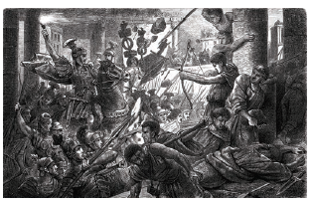
Topic: Rome, the Late Republic to the Lex Manilia
c. 133-66 BC
Year 12 Unit 3: Societies and Change
An artist’s depiction of the entrance of Cornelius Sulla into Rome, where he was appointed as dictator in the first century BCE
Lucius Cornelius Sulla Felix

Slide 2
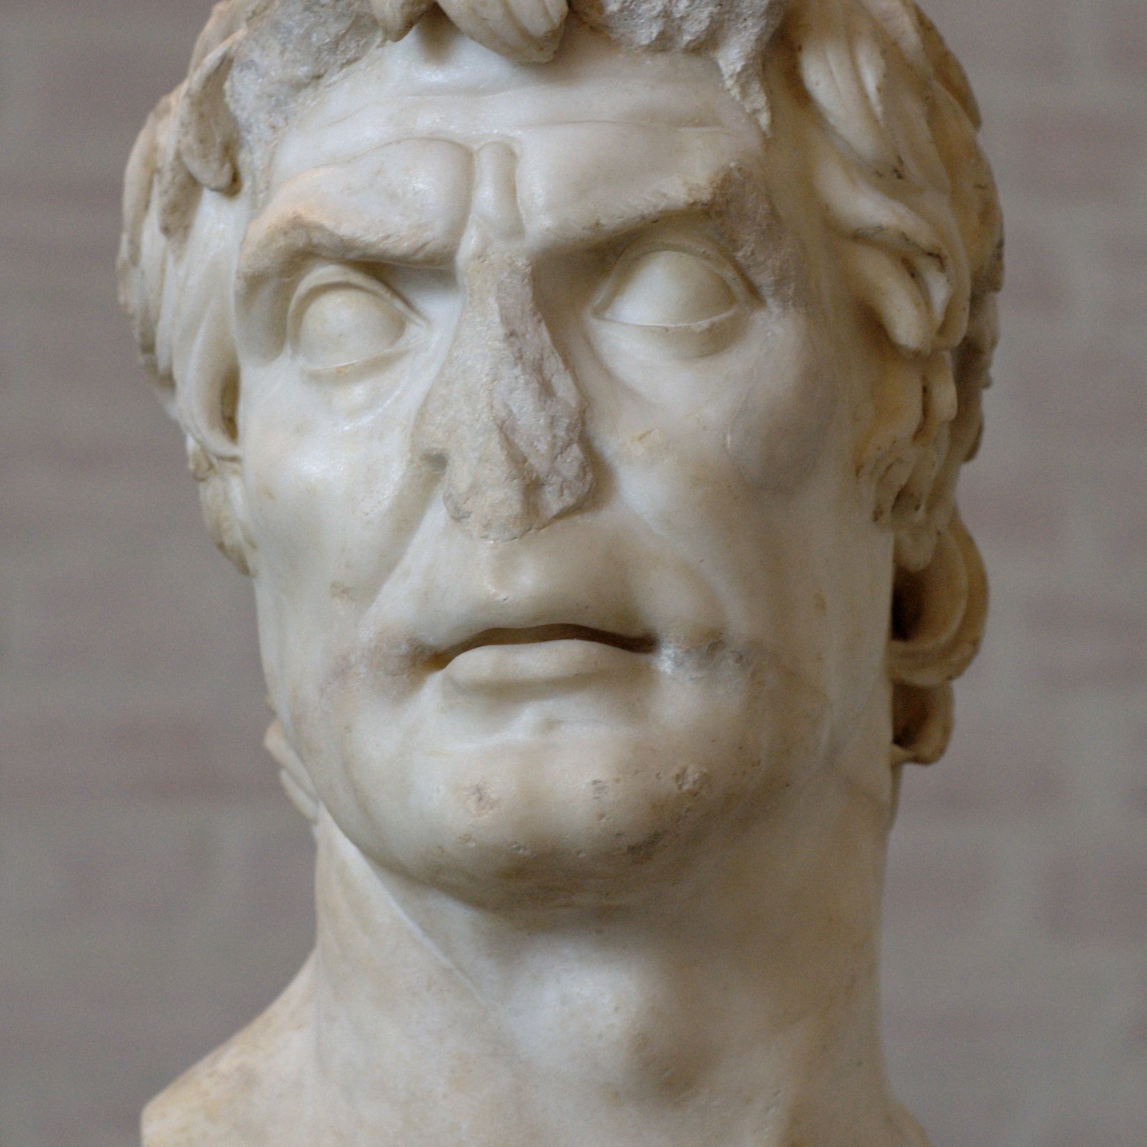
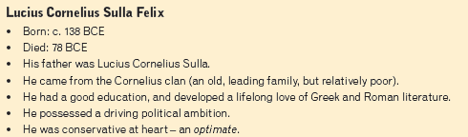


Lucius Cornelius Sulla Felix
Source 1: Plutarch, 75 BCE, Life of Sulla, 6.7-6.8
Source 2: Sallust, c.41-40 BCE, The Jugurthine War, chapter

Slide 3
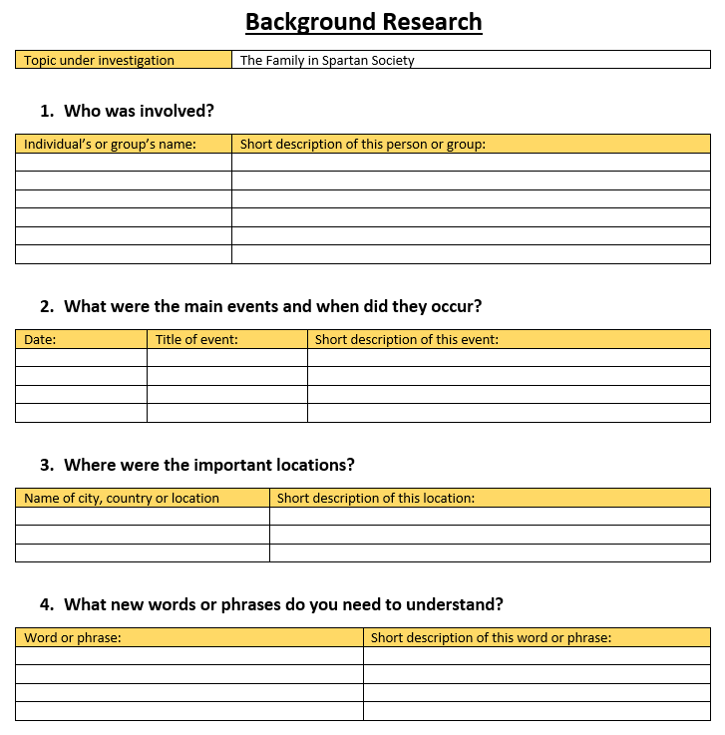
Sulla’s Career
Experienced military success against Jugurtha under Marius’s command
Involved in ending the Social War of 90 BCE.
Task: Go online and conduct background research about the Social War of 90 BCE.
Fill in your Background Research handout to assist in organising your information

Slide 4
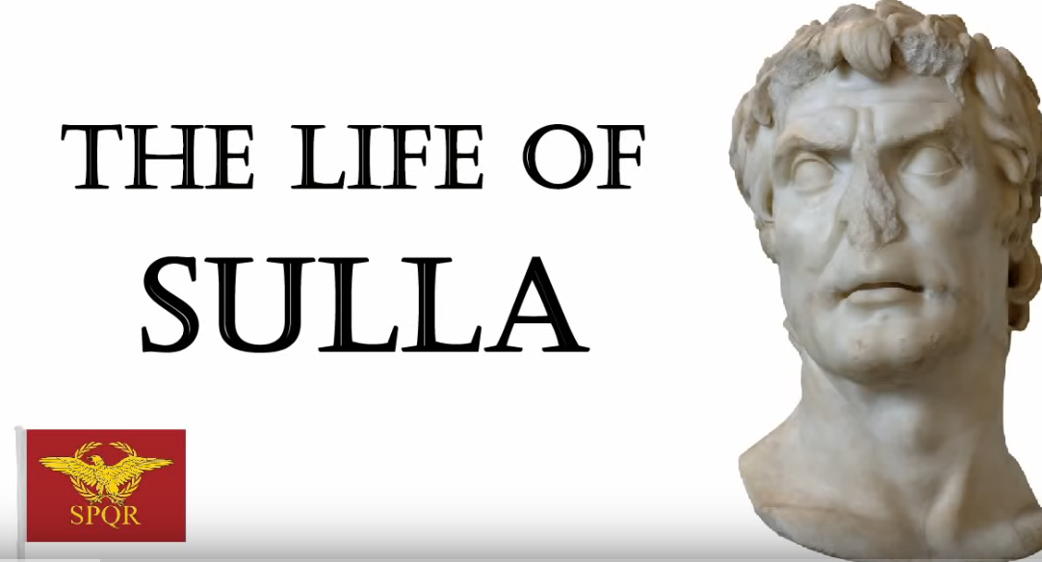
Let’s Watch
The Life of Sulla: Rome’s first Dictator for Life
https://www.youtube.com/watch?v=DqPR9JYYowk
Video is on Connect
Is this source reliable evidence? Let’s assess this video after we watch!

Slide 5
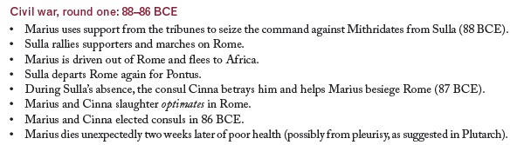
Civil Wars: Accession to Power

Slide 6
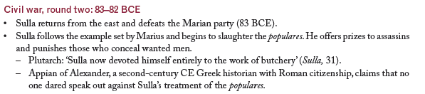

Civil Wars: Accession to Power

Slide 7
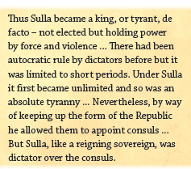
Sulla - Dictator
Sulla is declared dictator by the Senate, with no set time limit for his term in office (82 BCE)
Source 3: Appian, c. 162 CE, The Civil Wars, Book 1.99-1.100

Slide 8
Sulla’s Dictatorship
Sulla ruled unopposed for three years, until his retirement
Sulla implemented a significant number of reforms to the magistracy
Through these reforms, Sulla aimed to restore stability to Rome by strengthening the Senate, reducing the power of tribunes and reorganising the courts

Slide 9
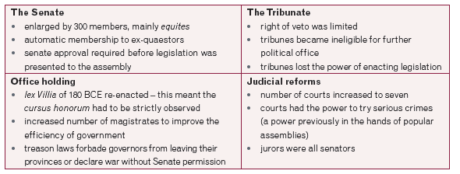
Changes to the Magistracy

Slide 10
Summary
Despite positive reforms, Sulla’s dictatorship was characterised by violence, making the people fearful of individuals with too much personal power

Slide 11

Source Study
Read through the sources and answer the corresponding questions using well-structured sentences
Ensure evidence from the source is referenced to support your answer

Slide 12
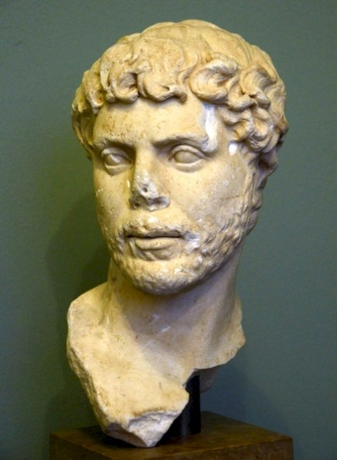
Appian of Alexandria
Greek historian of the conquests by Rome from the republican period into the 2nd century CE
Appian held public office in Alexandria (Egypt). He gained Roman citizenship and went to Rome, practiced as a lawyer, and became a procurator (financial agent of the government)
His work on the civil wars, dealing with the period from Tiberius Gracchus to Sulla, is a major historical source.
Appian was a conservative supporter of the imperial system and was often critical of and unsympathetic toward republican institutions and popular movements
Appian of Alexandria

Slide 13
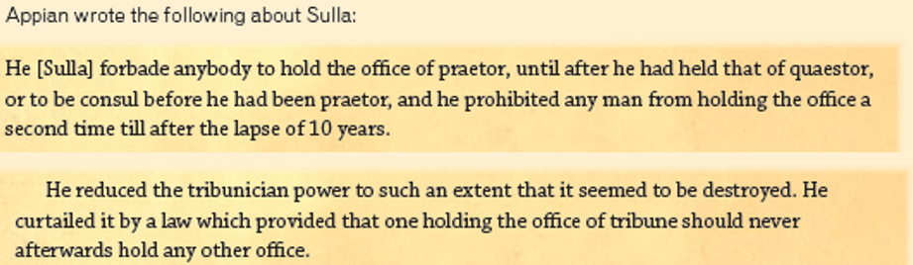
Source Analysis
Source 4: Appian, c. 162 CE, The Civil Wars, Book 1.100
Question:
Based on what you have learnt so far in this unit, how else had these rules been broken in recent years?

Slide 14
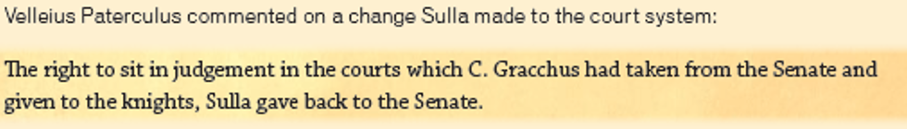
Source Analysis
Source 4: Appian, c. 162 CE, The Civil Wars, Book 1.100
Source 5: Velleius Paterculus, c. 30 BCE, Roman History, Book 2, 32
Question:
What was the result of the changes in law described in Source 4 and 5

Slide 15
Velleius Paterculus
Roman soldier, political figure, and historian whose work on Rome is a valuable if amateurish source for the reigns of Augustus and Tiberius

Slide 16

Source Analysis
Source 5: Velleius Paterculus, c. 30 BCE, Roman History, Book 2, 32
Source 6: Appian, c. 162 CE, The Civil Wars, Book 1, 100
Question:
What do you see as the objective behind the reforms in Source 5 and 6?

Slide 17

Source Analysis
Source 7: Appian, c. 162 CE, The Civil Wars, Book 1.100
Question:
What are your views on Appian’s conclusion of why Sulla did this?

Slide 18
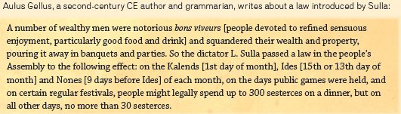
Source Analysis
Source 8: Aulus Gellius, c. 2CE, Noctes Atticae, Book 2.24.11
Question:
What do you see as Sulla’s motive behind this law? Was he being hypocritical?

Slide 19
Sources:
Augustyn, Adam., Bauer, P., et all. (2018). Appian of Alexandria. Encyclopaedia Britannica. https://www.britannica.com/biography/Appian-of-Alexandria
Augustyn, Adam., Bauer, P., et all. (2018). Velleius Paterculus . Encyclopaedia Britannica. https://www.britannica.com/biography/Velleius-Paterculus
Barrie, Alan., Cocks, M., et al. (2019). Senior Ancient History for Queensland. Cambridge University Press.
Conti, Leo., Easton, M., et al. (2016). Oxford Big Ideas Humanities and Social Sciences Western Australian Curriculum 7. Oxford University Press.

